Slide 1


Slide 2

OneCare, an innovative all-in-one healthcare web app designed to revolutionize the way you manage your health and wellness.
CS 691 CAPSTONE PROJECT

Slide 3

Team Member Roles and Responsiblities
Improvements made from Professor Feedback
Project Description
Team working agreement
Personas (at least 3)
MVP
Technologies
Algorithms
Diagrams
Architecture Diagrams, Context Diagram, ER Diagrams, Sequence
Diagram, State Diagrams, Cl
Sprint 1 Recap
Product Backlog
Stories or Tasks committed for this Sprint ( Storie and Acceptance Criteria)
Sprint Summary
Test Cases
Stories completed and Stories not completed
API usage in the Application
Metrics
Team velocity
Burndown Charts
Completed/Committed Ratio
Retrospective
Sprint Backlog (Stories planned for sprint 3)
Project Demo ( current sprint)
Github link

Slide 4

TEAM MEMBERS AND ROLES

Slide 5
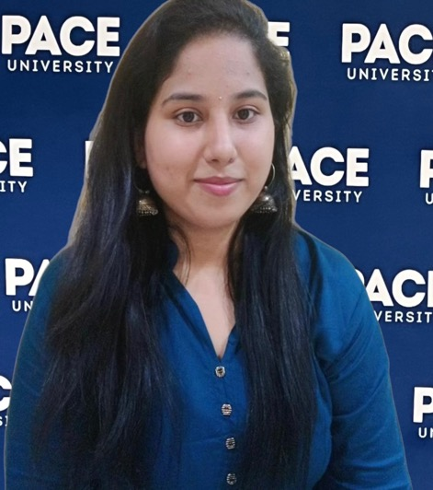
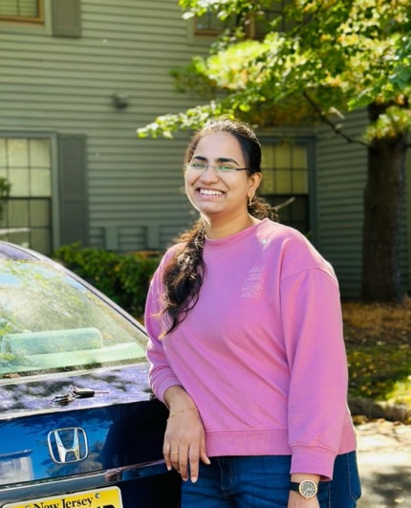
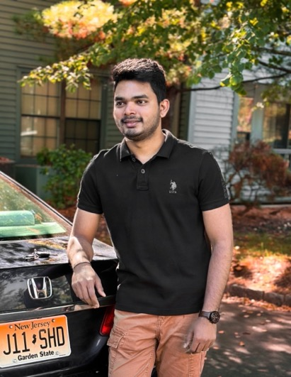
TEAM MEMBERS AND ROLES
Aishwarya More Software Developer & Business analyst (am99715n@pace.edu)
Naga Lavanya Mukku Backend Developer & Software test Engineer (nm26028n@pace.edu)
Shiva Krishna Maddela Software Developer & Devops Engineer (sm69485n@pace.edu)

Slide 6


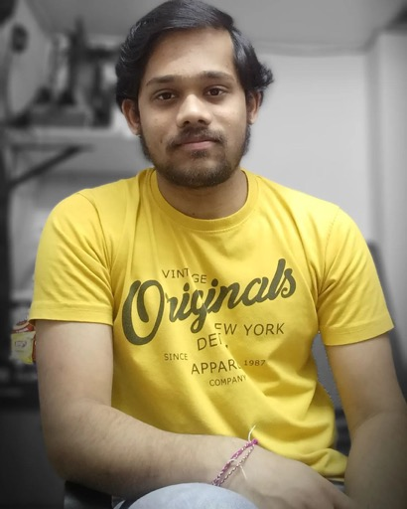
TEAM MEMBERS AND ROLES
Pushpak Kamisetti Software Developer & Machine Learning Engineer (pk39545n@pace.edu)
Afroze Fatima Software Developer (an75415n@pace.edu)
Shashidhar pinumalla Front End Developer (sp16592n@pace.edu)

Slide 7

PROJECT DESCRIPTION
OneCare is a comprehensive healthcare management application designed for both patients and doctors. It serves as a unified platform that facilitates seamless communication, appointment scheduling, and the organization of medical records, predict medicines based on symptoms using Deep learning Neural network (LSTM), medication reminders to stay on track with their treatment plans, while stress management tools, such as recorded meditation sessions, promote mental well-being. OneCare aims to simplify healthcare management and promote healthier lifestyles. Our app, OneCare Health, leverages Firebase's real-time database and authentication features to provide a seamless and secure experience for users. It enables patients to manage their health records, appointments, and prescriptions, while healthcare providers can efficiently access patient information and communicate with their patients.

Slide 8

Improvements made from Professor’s Feedback
Revised the format of personas to align with recommendations.
Incorporated changes in the PowerPoint presentation based on received feedback.
Ensured consistency and clarity in the presentation content.
Implemented enhancements to better showcase project progress and objectives.
Linked test cases to corresponding user stories to streamline testing process and traceability.
Ensured adherence to checklist guidelines for slide order and content inclusion.
Presented demo video effectively to highlight project functionality and achievements.

Slide 9

Team Working Agreement

Slide 10
TEAM WORKING AGREEMENT
Participation:
Prompt Attendance: Attend meetings on time.
Regular Attendance: Notify earlier if unable to attend.
Communication:
Zoom Meetings: Weekly, meaningful discussions with cameras on.
Whatsapp Group: Quick communication & urgent matters.
OneDrive: Sharing final deliverables & collaborative editing.
Database Management: Efficient organization of project data.
Work Distribution:
Equal Division: Fair allocation of tasks.
Deadline Responsibility: Complete tasks on time.
Collaboration: Seek help if needed.
Meetings:
Virtual Meetings: Every Tuesday & Wednesday via Zoom.
Facilitation: Productive discussions & progress tracking.
Meeting Minutes: Document for progress monitoring.

Slide 11

Personas

Slide 12
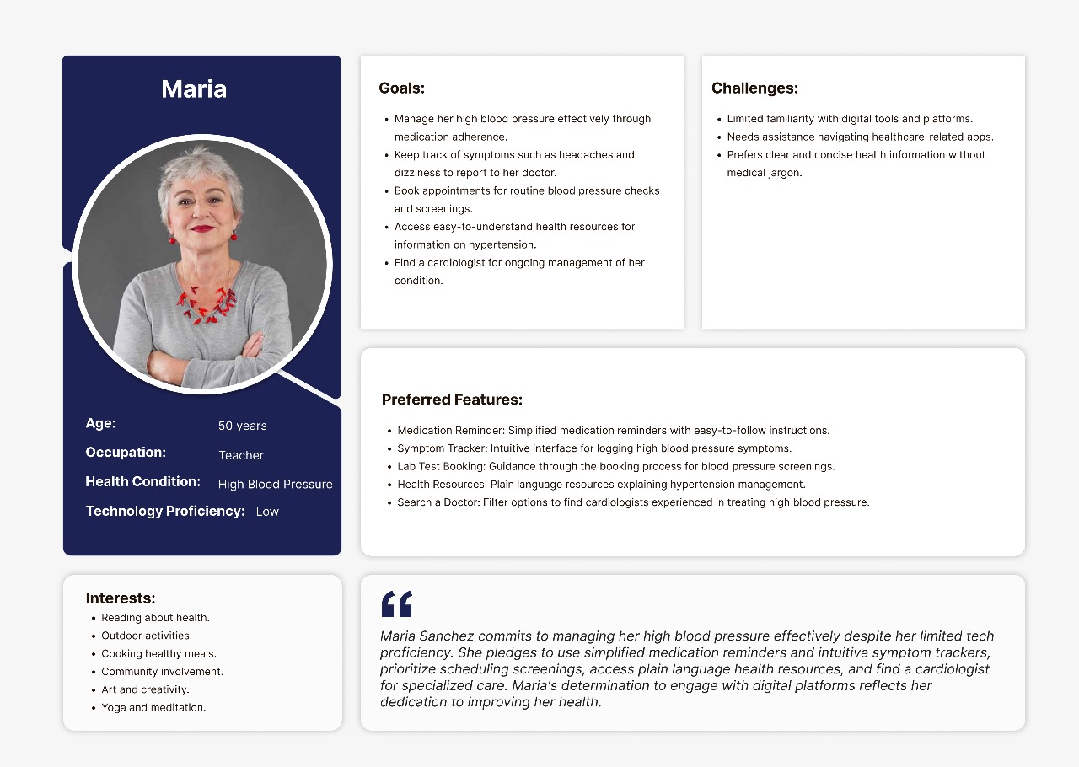

Slide 13
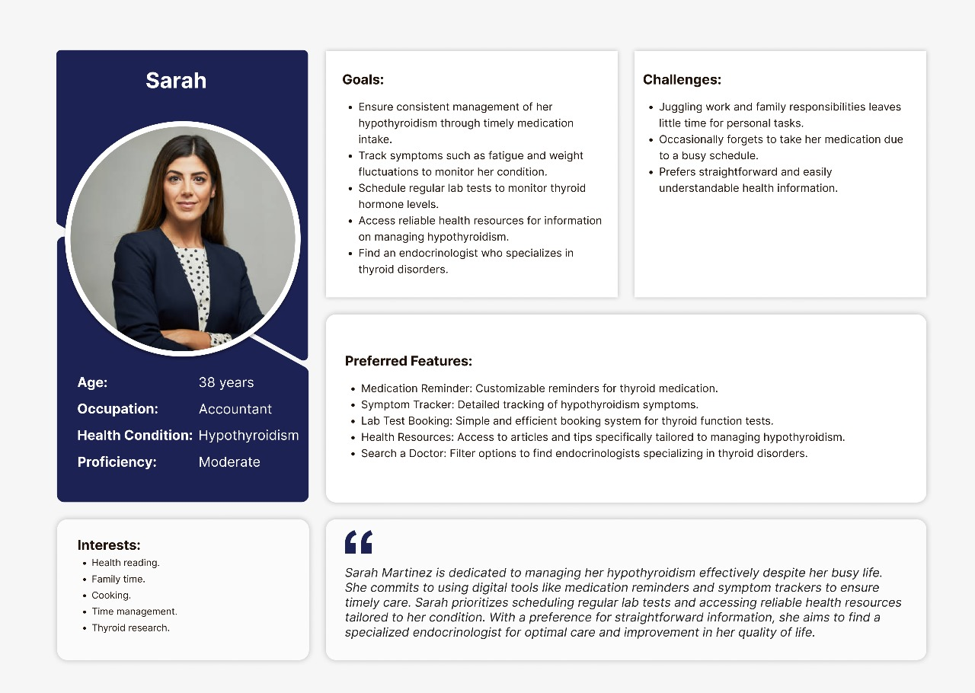

Slide 14
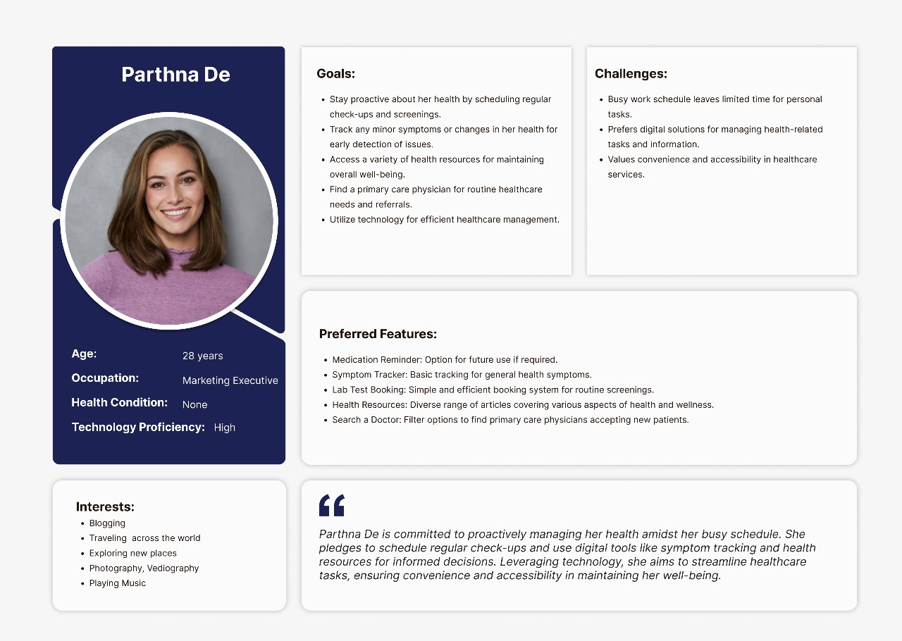

Slide 15


Slide 16
Minimum Viable Product (MVP)
Homepage
Appointment Booking
Medication Reminder
Lab Test Booking
Meditation Session
Search doctor
Health Resources
Symptoms Tracker

Slide 17













Technologies

Slide 18
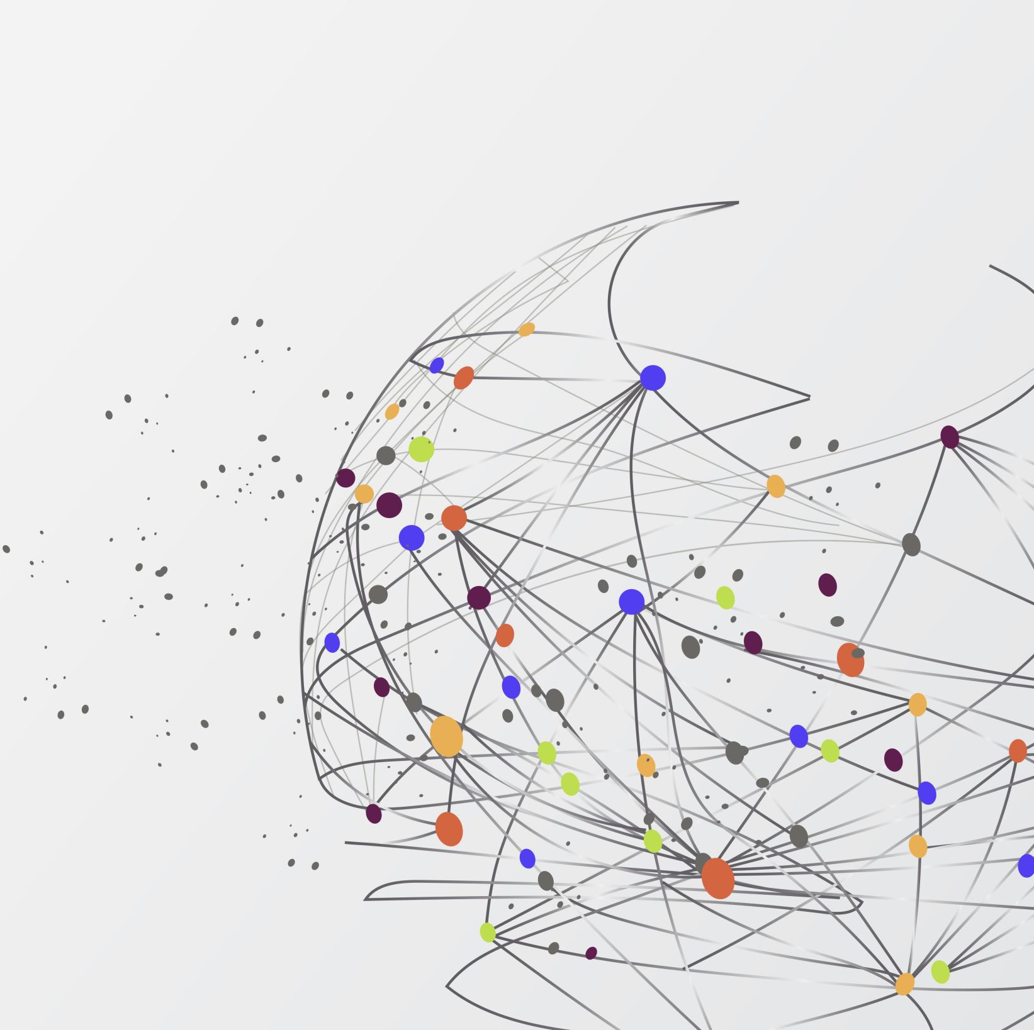
Algorithms
Utilizes K-Nearest Neighbors (KNN) Algorithm and Convolutional Neural Networks (CNN) Algorithm for symptom prediction.Integrates both models for comprehensive symptom tracking.
Feature Extraction:
Utilize pre-trained CNN to extract features from csv.
Use KNN with extracted features for classification or regression.
Training and Prediction:
Train CNN on for feature extraction.
Use KNN to make predictions based on the extracted features.
Ensemble Approach:
Combine predictions from both models for improved accuracy.

Slide 19

ARCHITECTURE DIAGRAM

Slide 20
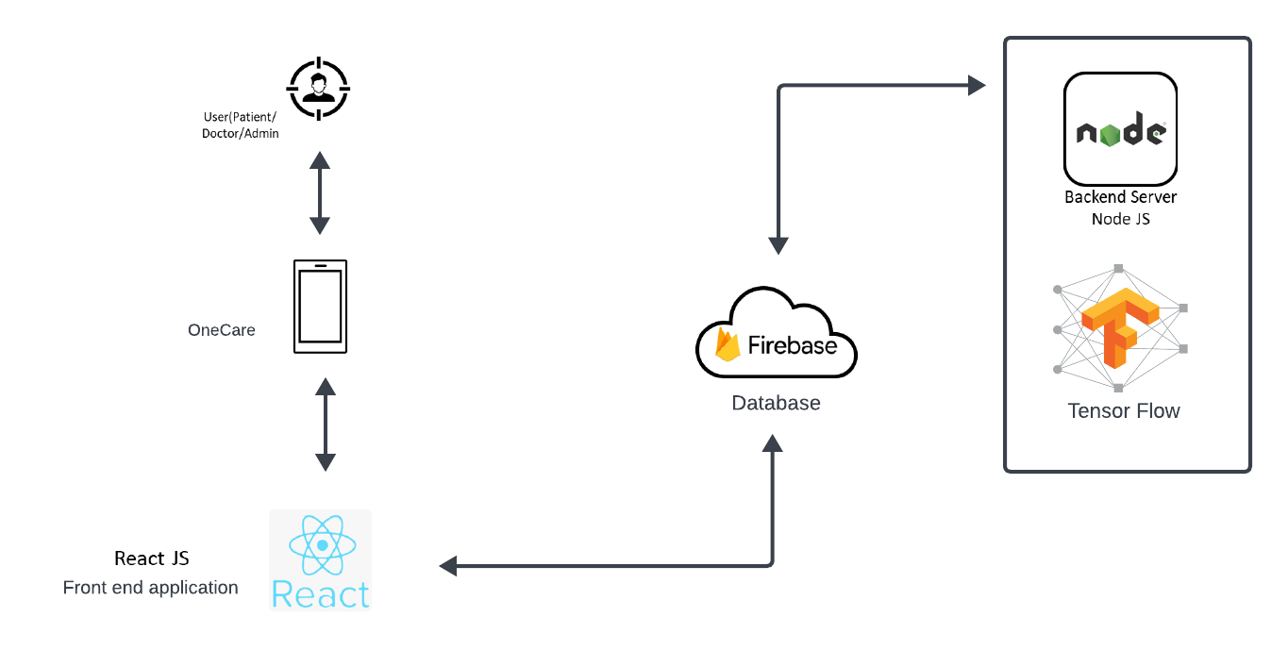

Slide 21

SEQUENCE DIAGRAM

Slide 22
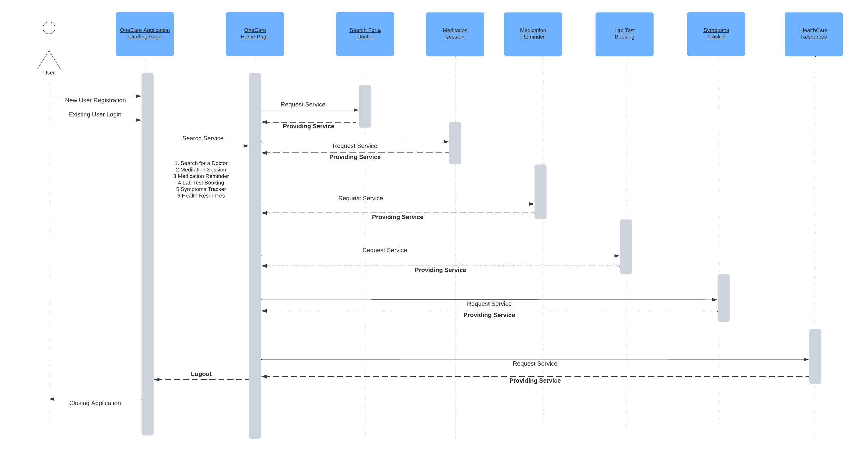

Slide 23

USE CASE DIAGRAM

Slide 24
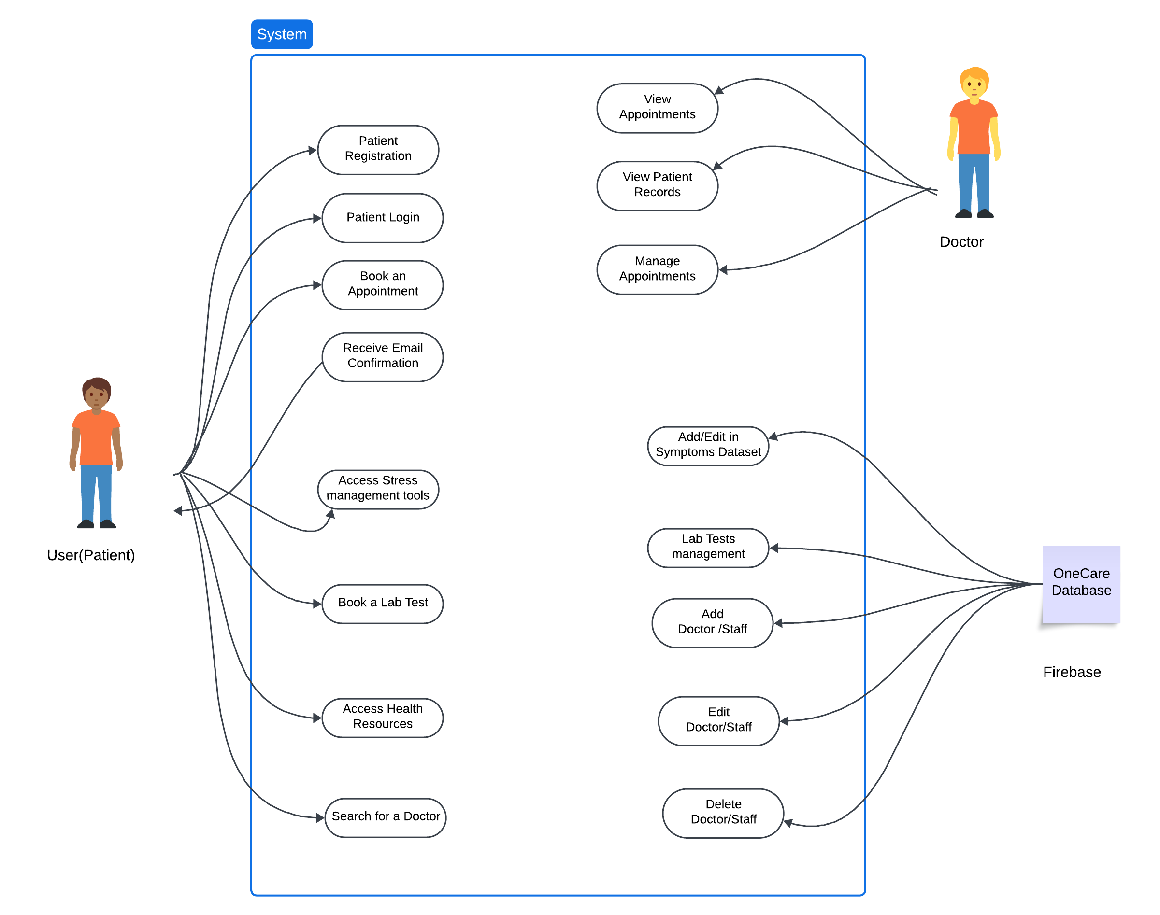

Slide 25
Sprint 1 Recap
1. Login & Signup
implementation of login and signup functionality for both doctors and patients.
Integrated authentication mechanisms to ensure secure access.
2. Forgot Password
Developed and deployed the forgot password feature for both doctors and patients.
Implemented email verification and password reset functionality.
3. Appointment Booking
Designed and implemented appointment booking system for patients to schedule appointments with doctors.
Integrated calendar functionality to allow doctors to manage their availability.
Implemented notification system to alert users about upcoming appointments.
4. Homepage
Created a user-friendly homepage with intuitive navigation for both doctors and patients.
Incorporated relevant information and features such as search functionality, quick access to appointments, and announcements.

Slide 26
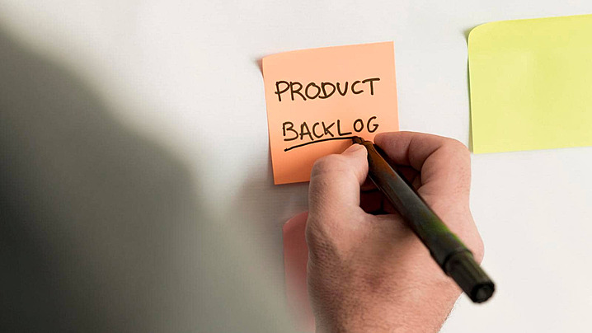
PRODUCT BACKLOG

Slide 27
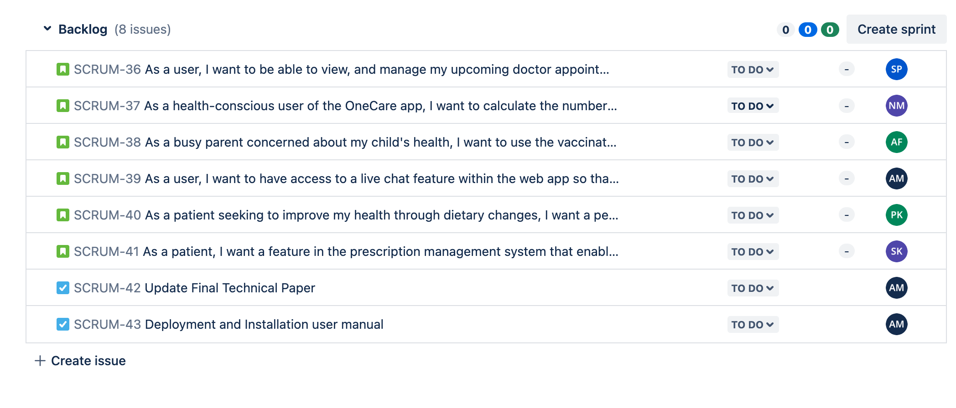

Slide 28

ACCEPTANCE CRITERIA AND USER STORIES

Slide 29
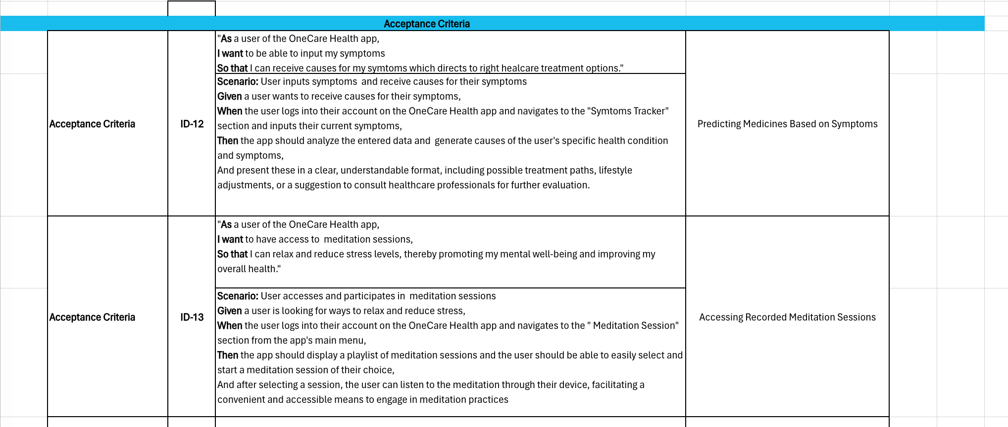
ACCEPTANCE CRITERIA AND USER STORIES

Slide 30
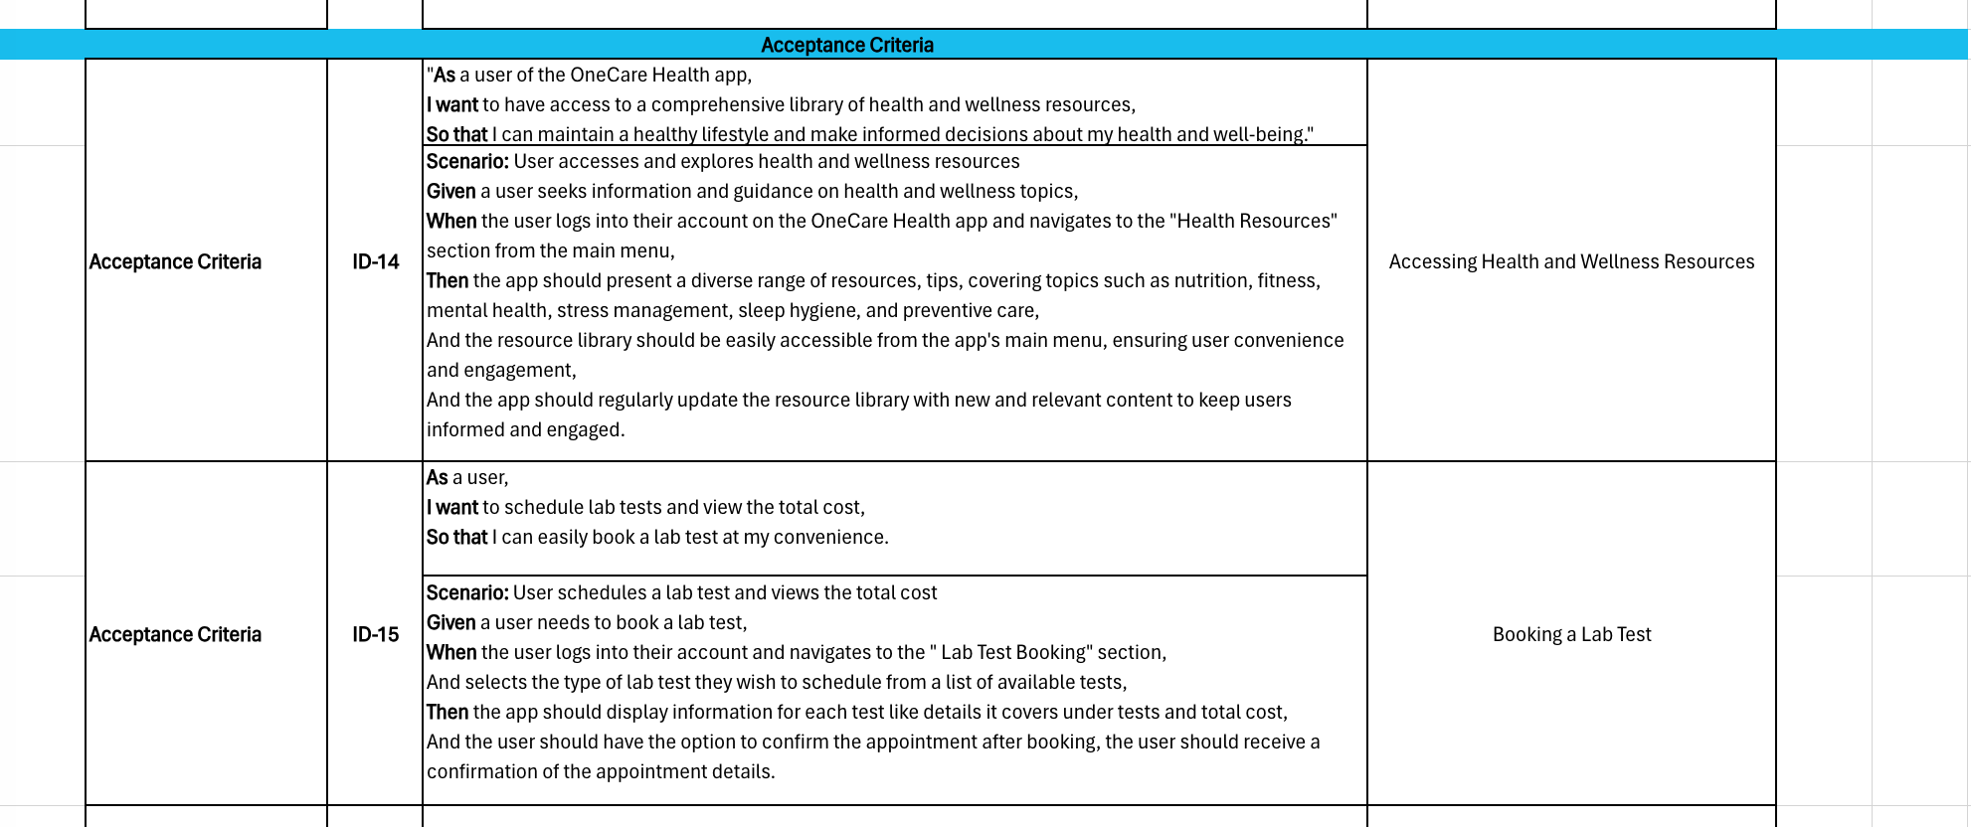
ACCEPTANCE CRITERIA AND USER STORIES

Slide 31
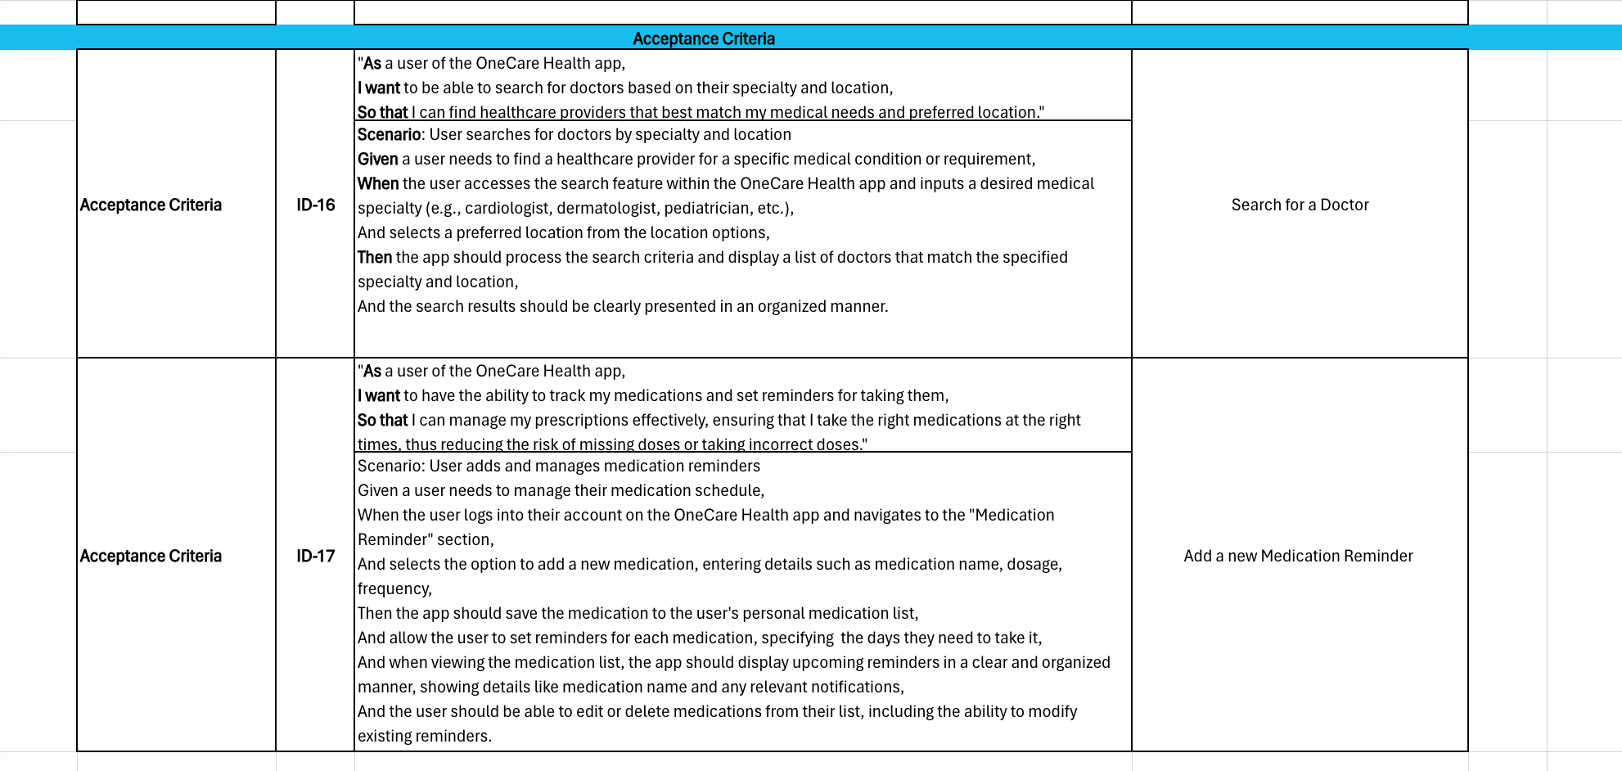
ACCEPTANCE CRITERIA AND USER STORIES

Slide 32

Sprint Summary

Slide 33
Sprint 1 Vs Sprint 2
Login –Doctor and Patient
Signup –Doctor and Patient
Forgot Password
Appointment booking
HomePage
Medication Reminder
Meditation session
Symptoms tracker
Search doctor
Health Resources
Lab Test Booking

Slide 34
TESTCASES

Slide 35
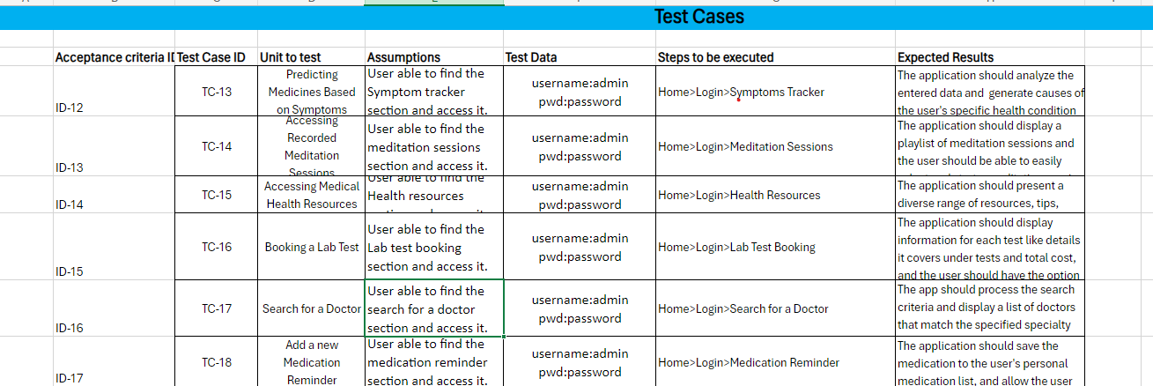

Slide 36

Stories Completed and Stories Not Completed

Slide 37
Stories Completed and Stories Not Completed
Story | Status | Date Completed
As a user access to a library of health and wellness resources, including articles, videos, and tips so that I can maintain a healthy lifestyle. | Done | 14/03/2024
As a patient, I want access to guided meditation sessions, so that I can relax and reduce stress levels. | Done | 15/03/2024
As a user, I want to schedule lab tests and view the total cost so that I can easily book a lab test at my convinience | Done | 13/03/2024
As a patient, I want to be able to input my symptoms and medical history, so that I can receive personalized recommendations for treatment options. | Done | 20/03/2024
As a user, I want to be able to track my medications and set reminders for taking them, so that I can manage my prescriptions effectively. | Done | 18/03/2024
As a user, I want to search for doctors based on specialty and location so that I can find the most suitable healthcare providers conveniently. | Done | 12/03/2024
Draft Technical Paper | Done | 20/03/2024

Slide 38
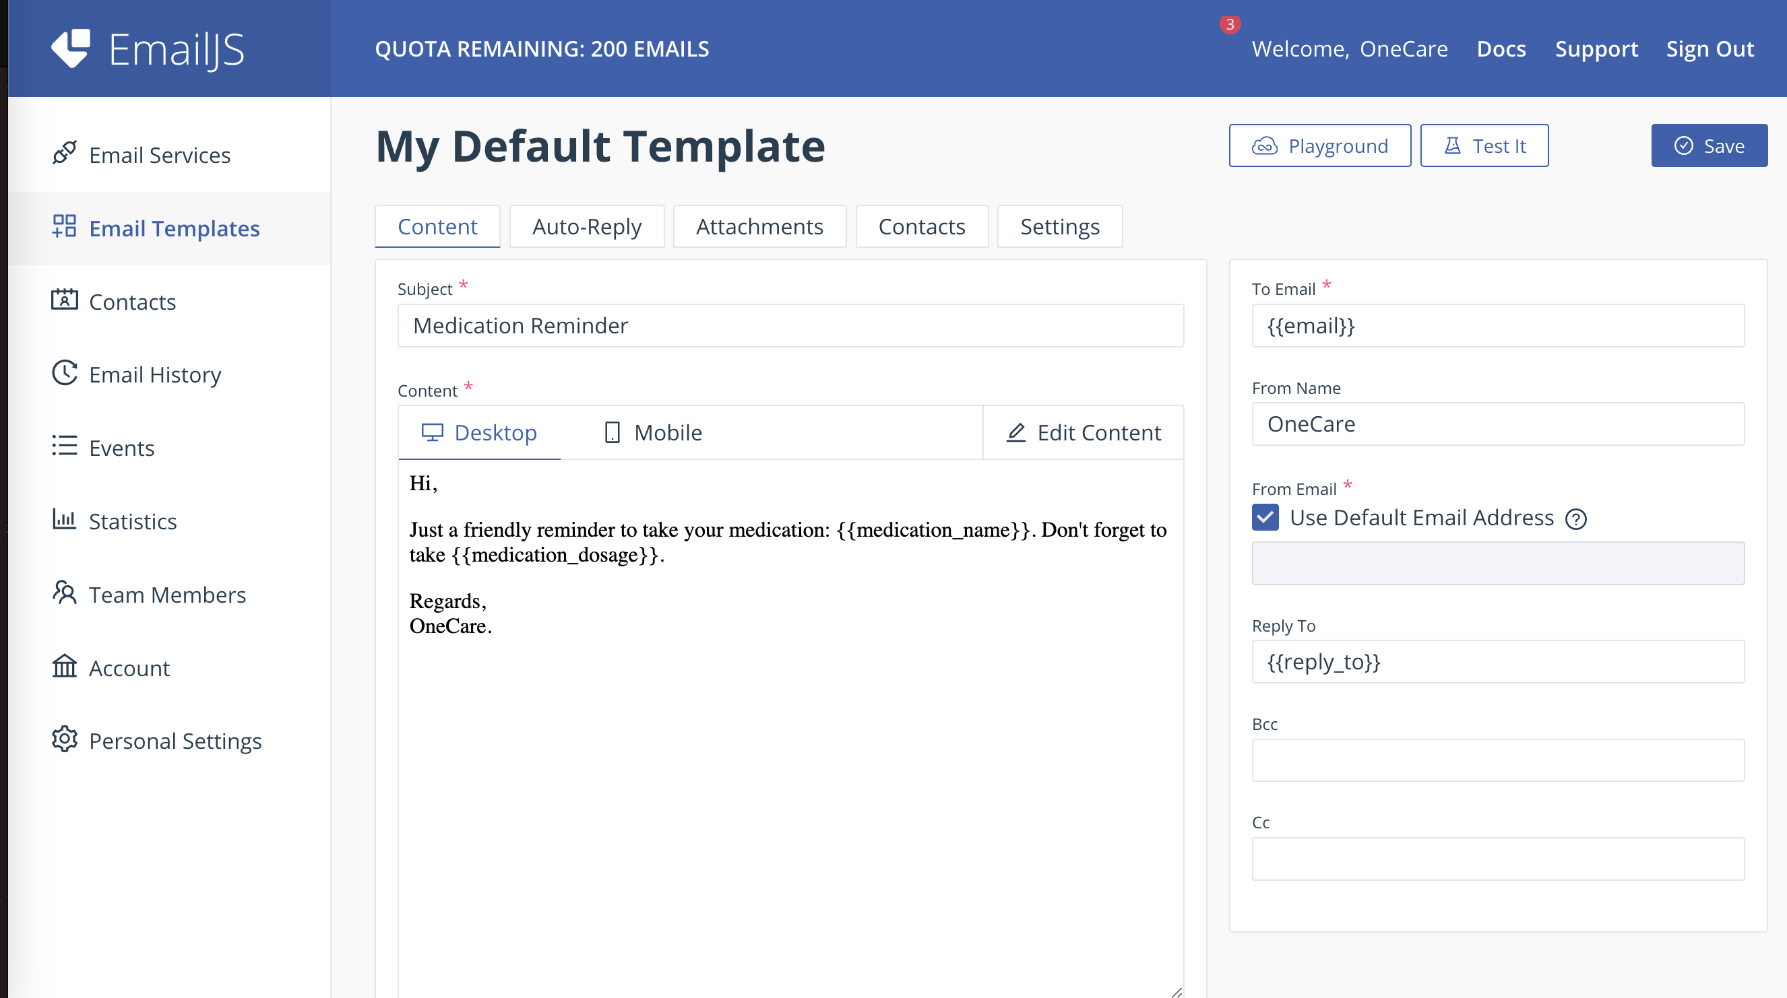
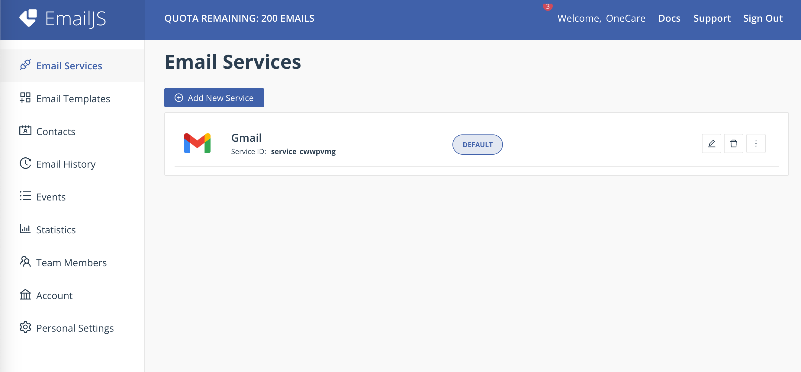
API usage in the Application

Slide 39
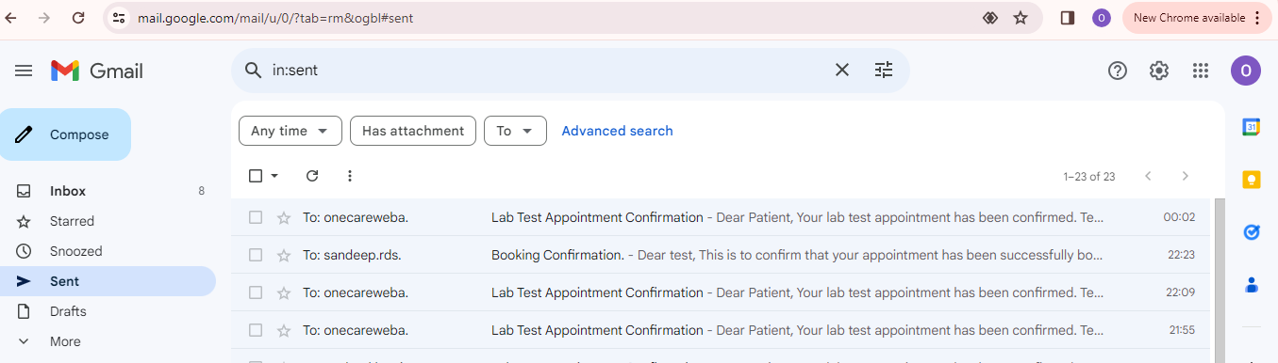
Email

Slide 40
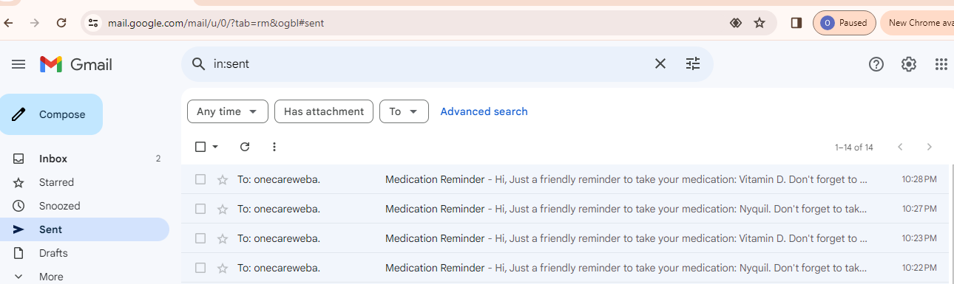
Email

Slide 41
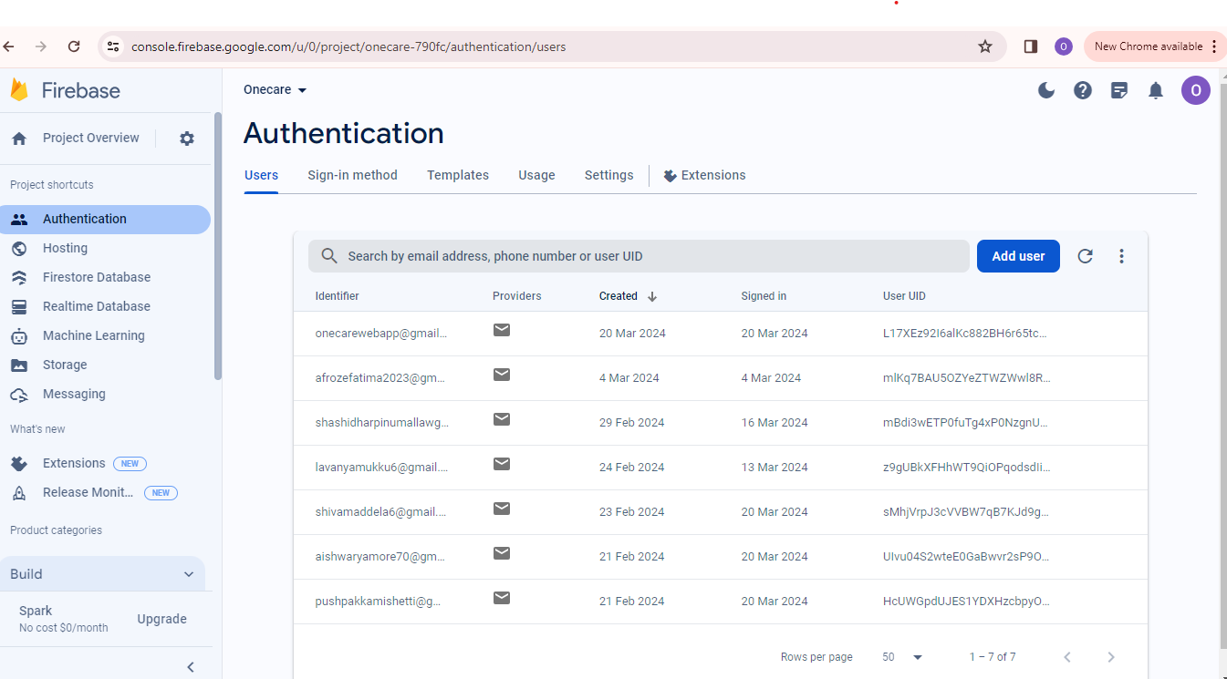
Firebase

Slide 42
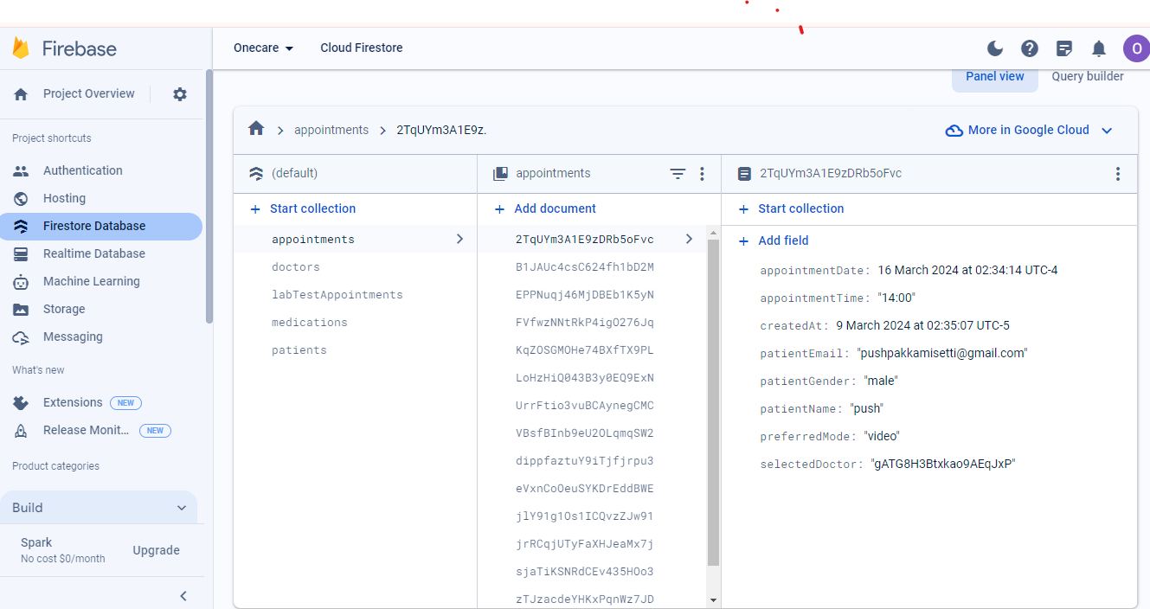
Firebase

Slide 43

Metrics

Slide 44
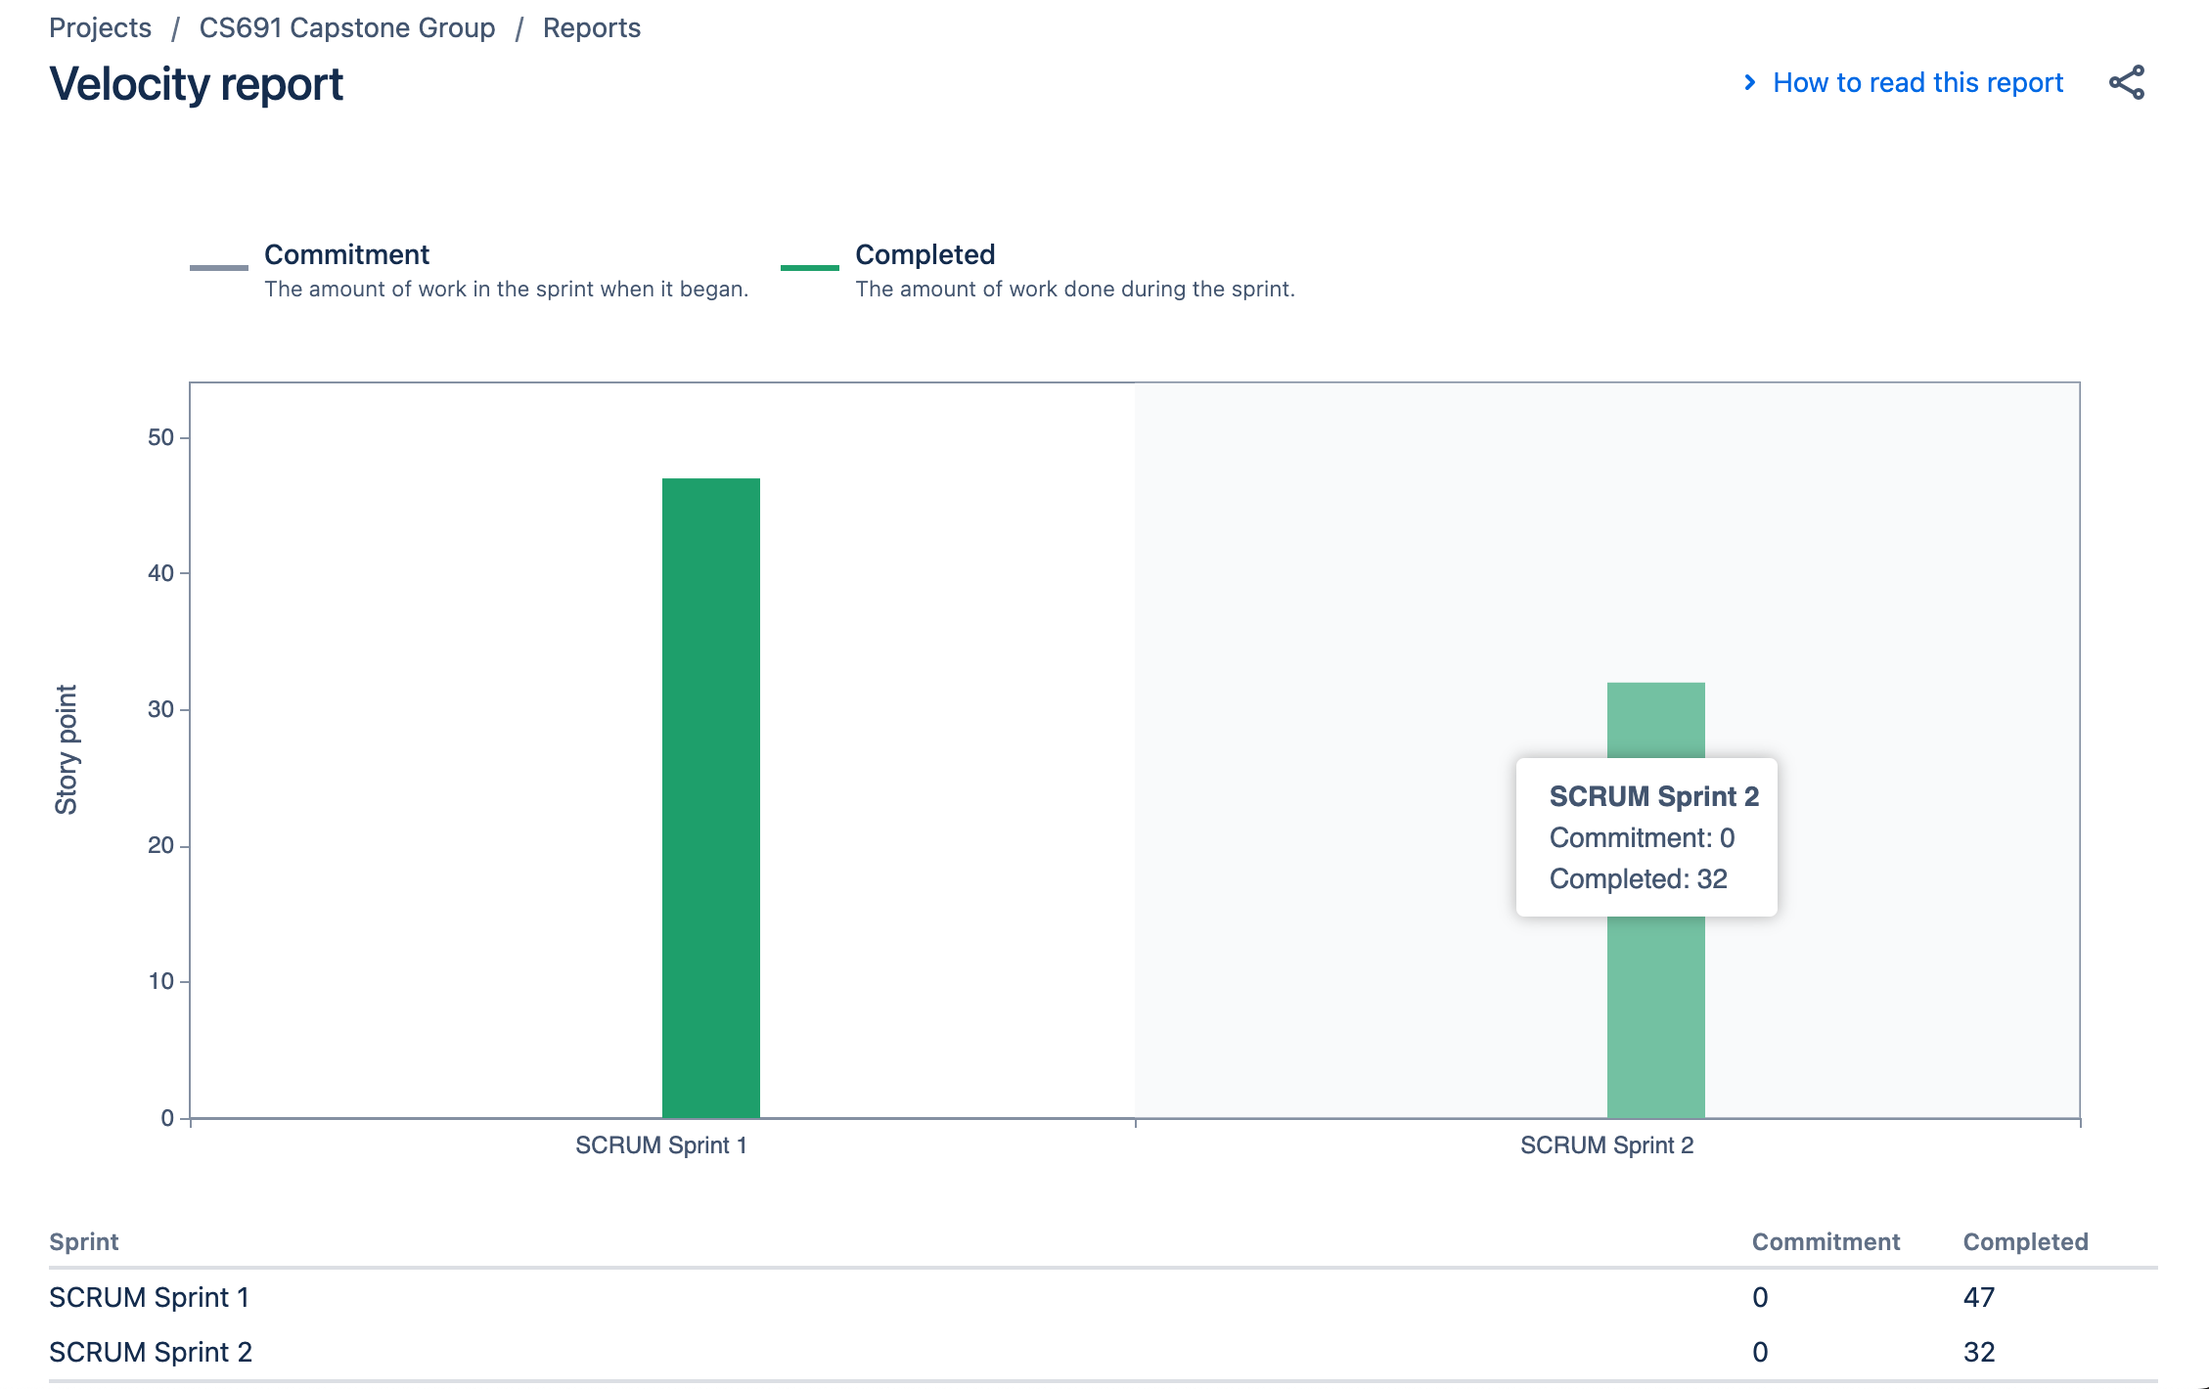
Team Members Velocity report

Slide 45
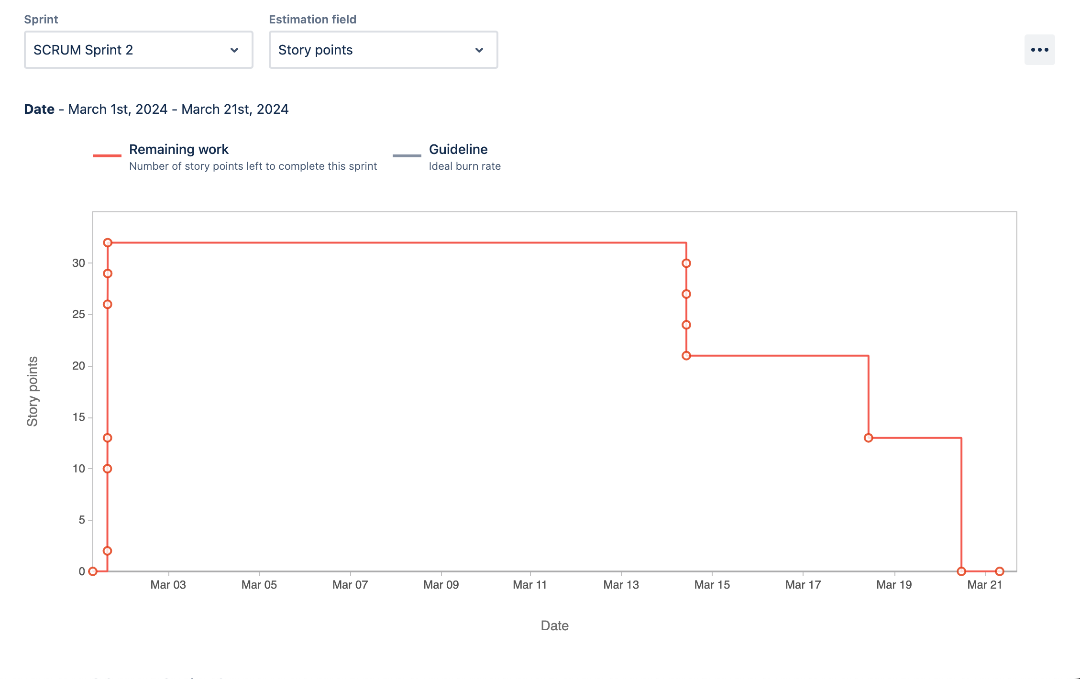
Sprint Burndown Chart

Slide 46

RETROSPECTIVE

Slide 47
What Went Well
Good Collaboration and pairing work done despite remote work.
Team Bonding became strong.
Started working in pairs to complete huge and difficult tasks.
Deliverables on time.
Incorporated professors feedback

Slide 48
What needs Improvement
Meeting times planing
Coding redundancies
Discussions about what should be done in the presentations and sprints should be discussed in every meeting.
Updates on how much the work is done should be discussed in the meetings.

Slide 49
Next Steps
Establish a better Planned schedule for meetings.
Guarantee all stories have clear acceptance criteria before picking them up.
Update Documentations more better
Discussions on presentation topics and iterative updating of the presentation.

Slide 50
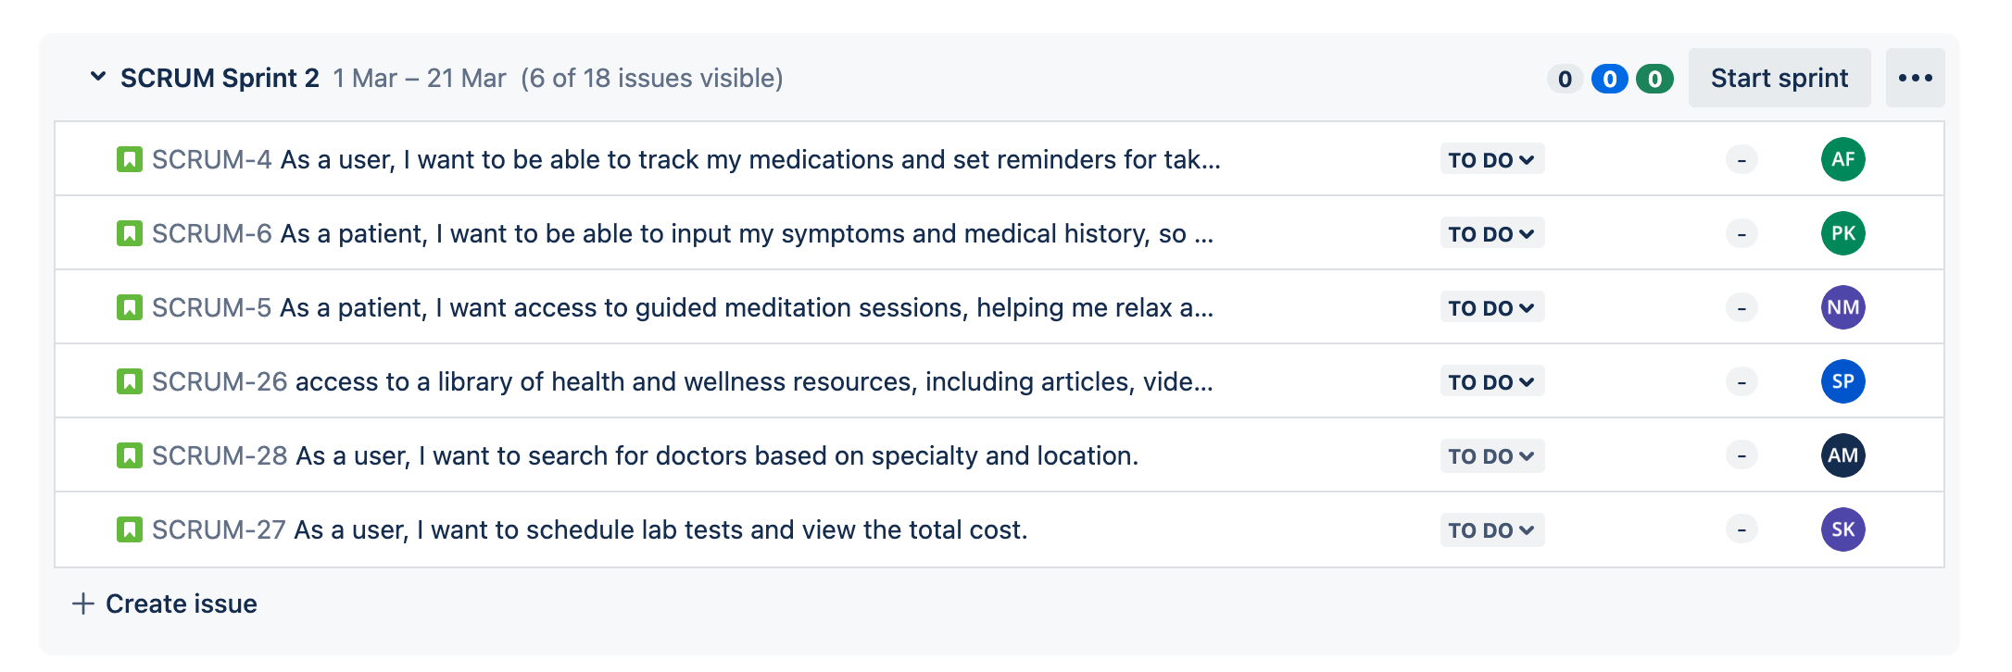
Stories planned and committed for sprint 3

Slide 51

Project Demo – Sprint 2

Slide 52

Links
GitHub source code : https://github.com/more-aishwarya/OneCareCapstone
Github Wiki page : https://github.com/more-aishwarya/OneCare/wiki/OneCare-%E2%80%90-Pace-University-Capstone-Project

Slide 53

THANK YOU

